Slide 1

Handwritten Alphabet Recognition with Machine Learning on the MNIST Dataset

Slide 2
ABOUT US
About us
TEAM MEMBER 1:
I am kirankumar pamarthi I have 3 Years of experience as a Junior Engineer at Mohan Spintex, I cultivated a passion for utilizing data to optimize processes and gain valuable insights. Motivated by the vast opportunities in data science, I aim to strengthen my skills and contribute to advancements in AI, machine learning, and data analysis. With an engineering background, I aspire to tackle complex industry challenges and make a meaningful impact through data-driven solutions.
TEAM MEMBER 2:
I am Surya, a 2020 graduate in Mechanical Engineering, eager to embark on a career in data science. With a strong foundation in engineering principles and a passion for leveraging data-driven solutions, I am motivated to contribute to the growing field of data science and its impact on various industries.

Slide 3
AGENDA
1. Introduction
2. Dataset Exploration
3. Data Pre-processing
4. Exploratory Data Analysis (EDA)
5. Model Training and Evaluation
6. Model Comparison& Insights
7. Conclusion
8.Q/A

Slide 4







1. Introduction
PROBLEM STATEMENT:
Recognize handwritten alphabets from image data using machine learning techniques.
OBJECTIVE:
Preprocess the image files and create a pandas data frame for the MNIST dataset. Build a model that can recognize handwritten alphabets and compare various ML models. Develop a lightweight model with low latency for deployment. Provide analysis of the data and model performance.
LIBRARIES USED:

Slide 5
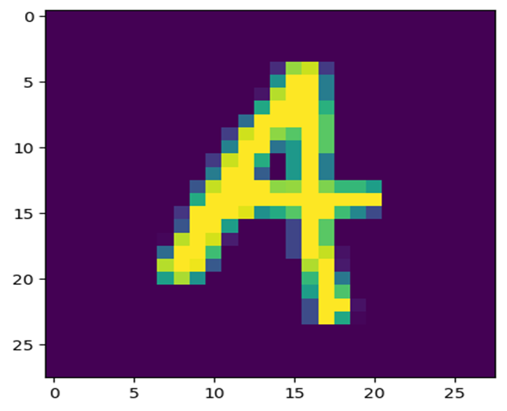
2. Dataset Exploration
Description:
MNIST, the "Modified National Institute of Standards and Technology" dataset, is a widely recognized dataset in computer vision. It consists of handwritten images and has been used for benchmarking classification algorithms since 1999. MNIST continues to be a valuable resource for researchers and learners in the field of machine learning.
Extracting MNIST Dataset from ZIP File:
1. Total number of files in the dataset: 26
2. The total length of images and labels: 372451
3. Size and shape of the image: 784(28x28) pixels
4. Original data set image

Slide 6
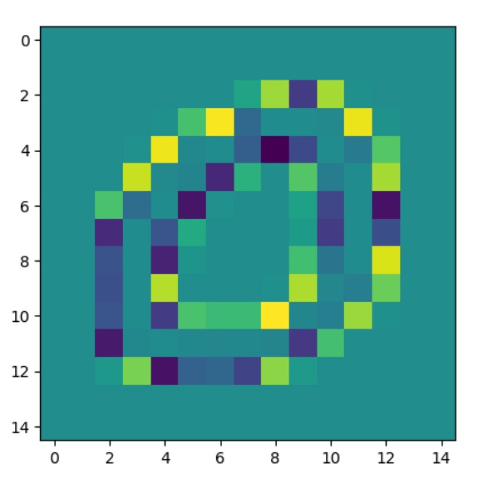
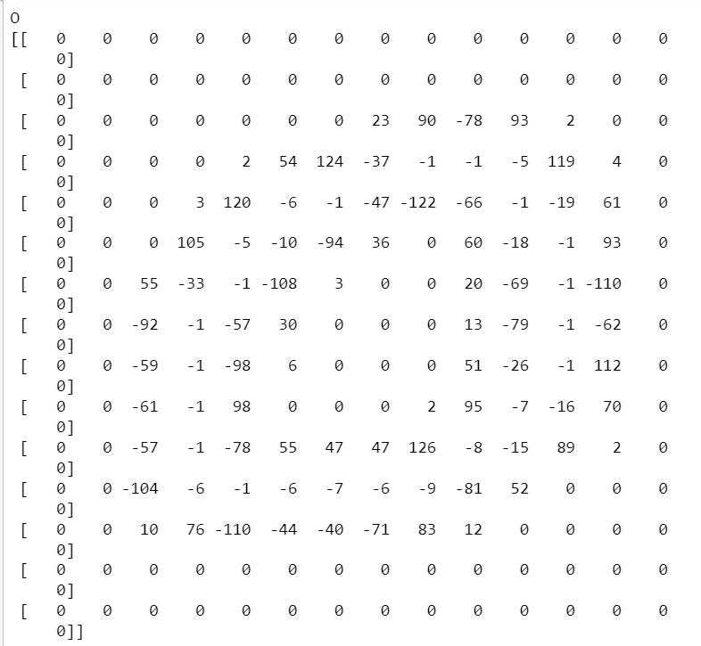
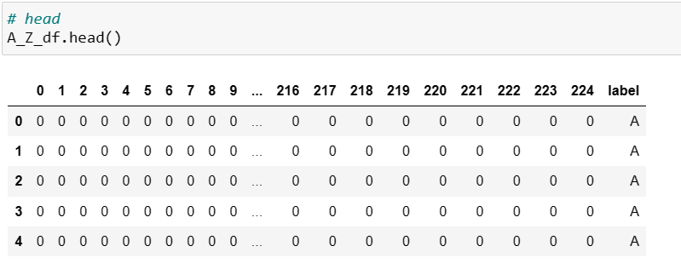
3. Data
Pre-processing
Convert The Images Into Array Format By Using Np. Array ().flatten
1. Resize The Image Size:15x15(225) pixels
2. After Resized Length Of Images And Labels:372451
3. Convert The Images Into Array Format By Using Np. Array ().flatten
4. Create A Data Frame

Slide 7
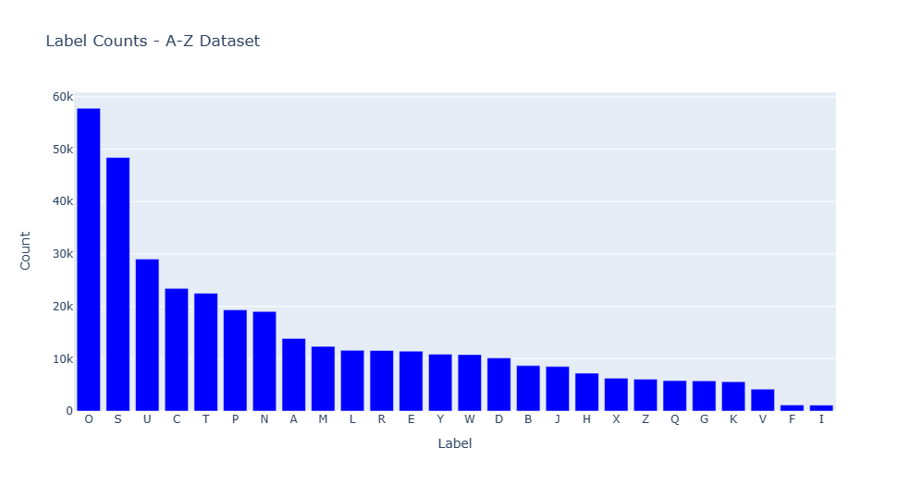
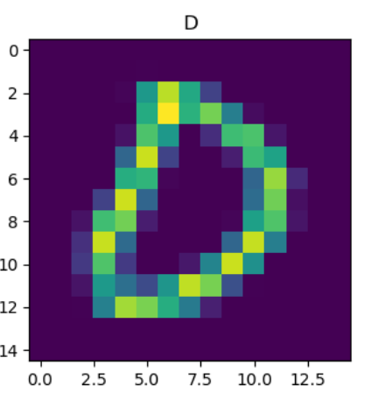
4. Exploratory Data Analysis (EDA)
Perform exploratory data analysis to gain insights into the dataset. Analyze the distribution of labels, and examine any patterns or variations in the data
OBSERVATION:
The counterplot reveals that the label "O" has the highest count in the dataset, with approximately 57,825 occurrences. Following "O", the label "S" has the second highest count, with around 48,419 occurrences. These counts indicate the frequency of each label within the dataset

Slide 8
5. Model Training and Evaluation
SPLITTING DATA INTO TRAINING AND TESTING SETS:
The dataset is split into training and testing sets to evaluate the model's performance. The training set is used to train the model, while the testing set is used to assess how well the model generalizes to unseen data.(70-30)
X_TRAIN shape of numerical :(260715, 225). X_TEST shape of numerical:(111736, 225)
Y_TRAIN shape of labels :(260715,). Y_TEST shape of labels :(111736,).
EIGHT classification algorithms were trained on the preprocessed dataset to recognize the handwritten alphabets. The performance of each model was evaluated using commonly used metrics such as accuracy, precision, recall, and F1-score.
Algorithms
1. Logistic Regression
2. Decision Tree
3. Random Forest
4. K-Nearest Neighbour
5. Support Vector Classifier
6. Gaussian Navie_Bayes
7.AdaBoost
8. XG-Boosting
Metrics
Accuracy = (Number of Correctly Classified Samples) / (Total Number of Samples).
Precision = (Number of True Positives) / (Number of True Positives + Number of False Positives).
Recall = (Number of True Positives) / (Number of True Positives + Number of False Negatives).
F1 Score = 2 * (Precision * Recall) / (Precision + Recall).

Slide 9
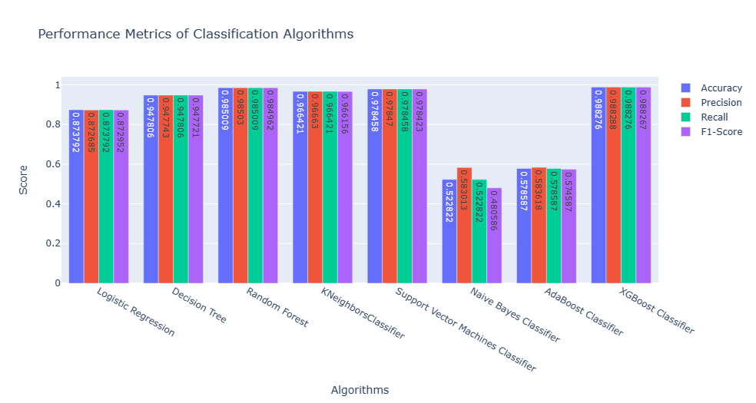
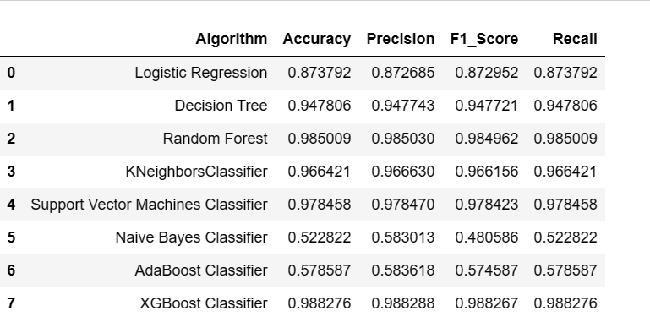
6. Model Comparison& Insights

Slide 10
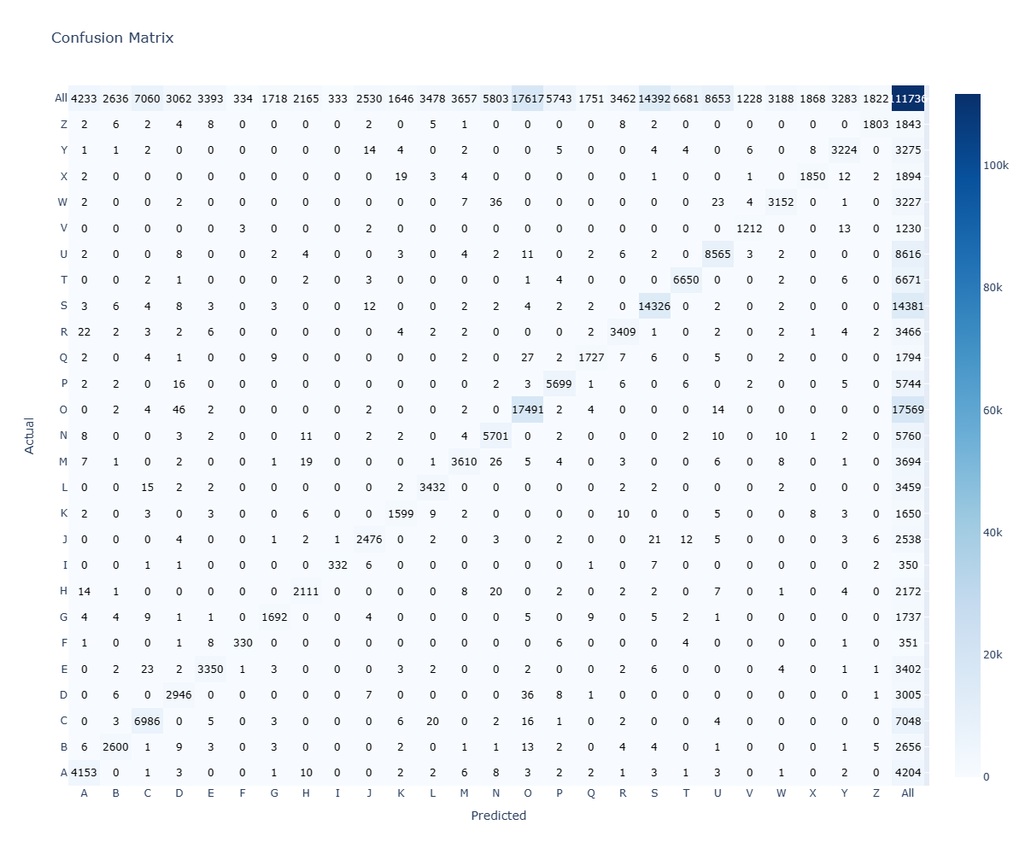
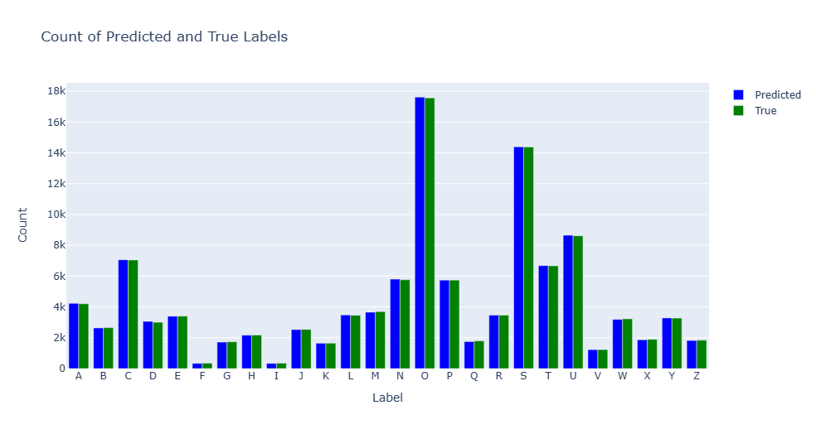
XG-BOOST
The high accuracy score of 0.988276 suggests that the true and predicted values in the classification task are very close to each other. This indicates that the XGBoost model was able to accurately classify the handwritten alphabet images in the dataset, resulting in minimal discrepancies between the true values and the predictions. The plot of the true and predicted values would likely show a strong alignment, further supporting the model's ability to closely match the actual labels.

Slide 11

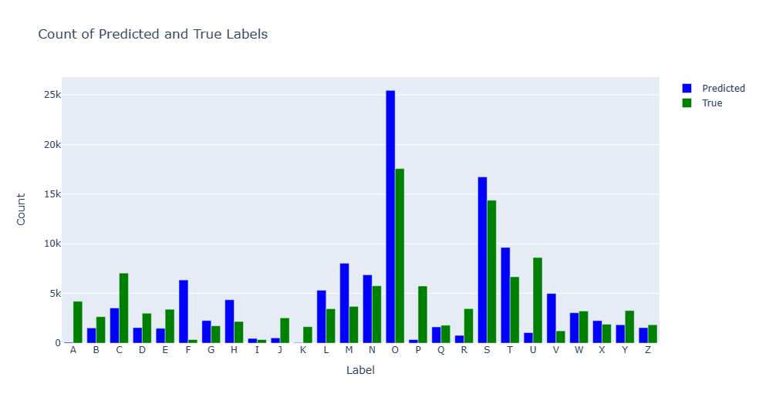
GAUSSIAN NAVIE BAYES
In the case of Naive Bayes, the accuracy of 0.522822 indicates that the model's predicted values do not closely align with the true values. The plot of true and predicted values would show a significant deviation or discrepancy between the two. This suggests that the Naive Bayes model may not be effective in accurately predicting the classes of the handwritten alphabet images, as indicated by the low accuracy

Slide 12
7. Conclusion
1. Importing files can be challenging, and it is crucial to ensure proper file handling and data preprocessing techniques to avoid errors. 2. Execution times of SVM and XG Boost reach around 1 hour.
3. Among the evaluated algorithms, XG Boost Classifier and Random Forest consistently outperform others in terms of accuracy, precision, F1-score, and recall, making them ideal choices for accurate predictions.
4. Naive Bayes Classifier performs poorly compared to other algorithms, indicating its limited effectiveness for this dataset.
5. For low-latency requirements, Decision Trees, Support Vector Machines (SVM), and Logistic Regression are recommended as they provide relatively faster prediction times.
6. Overall, XG Boost Classifier and Random Forest stand out as the top-performing algorithms, providing a balance of accuracy, efficiency, and deployment suitability.
7. These findings can guide the selection of algorithms for similar image recognition tasks, considering factors such as accuracy, model size, latency, and execution time.

Slide 13


Slide 14

THANK YOU

